Slide 1
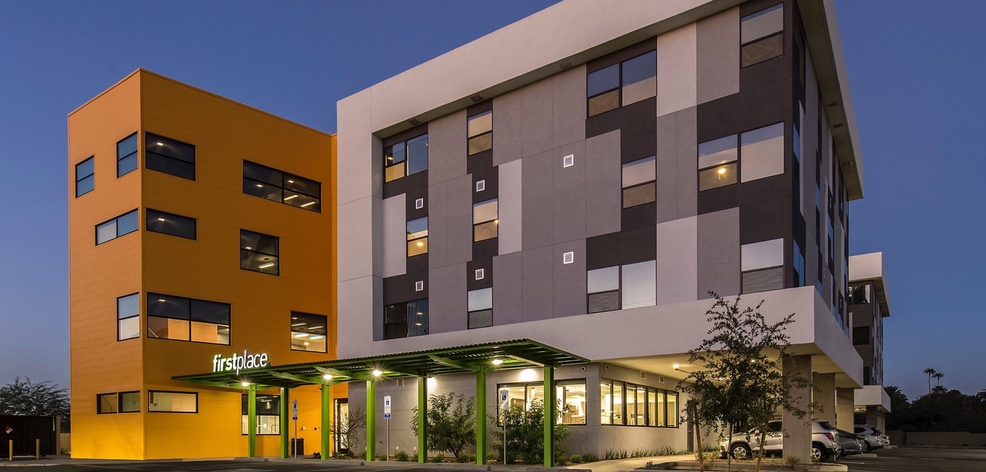

A diverse community of pride, purpose and possibility.®

Slide 2

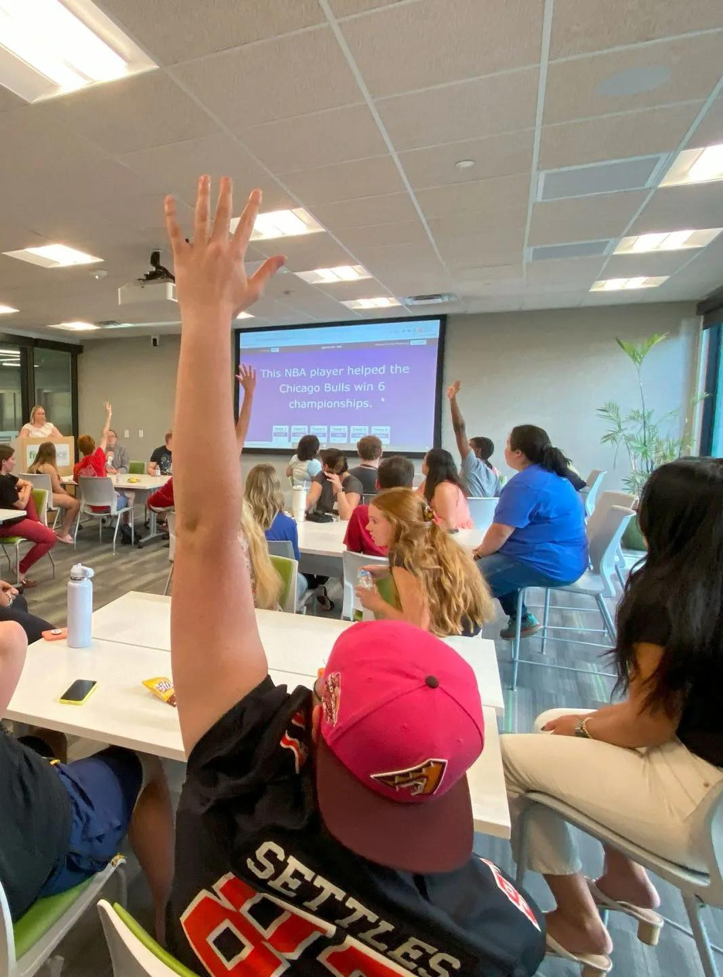
New Models of Housing & Independence for adults with Autism and/or I/DD
Who We Serve & Why It Matters
The First Place Model
Transition Academy & Learn4Indepedence
Inclusive Employment
Compassionate & Effective Healthcare

Slide 3
Population Served
1 in 31
70,000+
  children is diagnosed with an autism spectrum disorder (ASD) each year.*
  individuals with autism transition to adulthood each year.
The transition to adulthood presents many challenges:
  A more complicated, less supportive world
  Diminishing government services
  Limited employment and recreation opportunities
  Long waiting lists
  Limited supportive living options
  High turnover rates for providers
  Complex system that is challenging and intimidating to navigate​
*The Centers for Disease Control and Prevention estimates
Notes:
Given the population estimate and prevalence rates, approximately 70,700 to 111,600 youth on the autism spectrum turn 18 years old each year. This adds up to between 70,000 and 1,116,000 youth on the autism spectrum entering adulthood over the next decade.
https://drexel.edu/autismoutcomes/blog/overview/2019/June/Growing-numbers-of-young-adults-on-the-autism-spectrum/

Slide 4
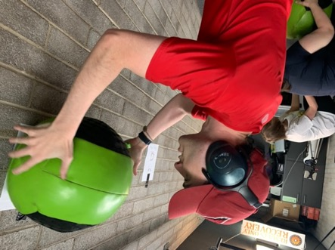

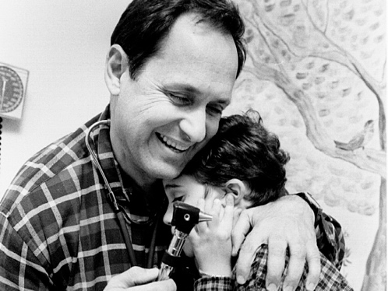
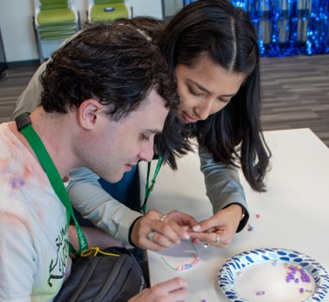

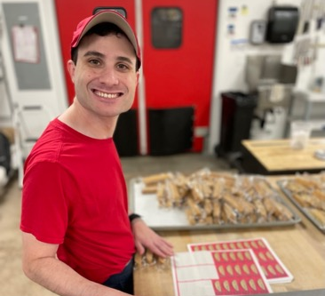


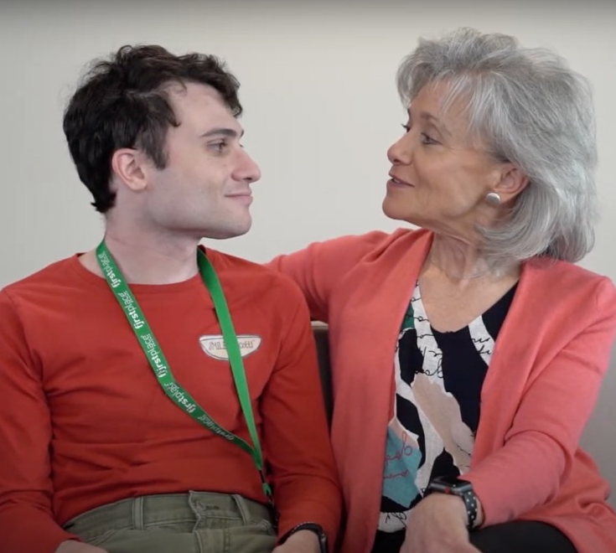
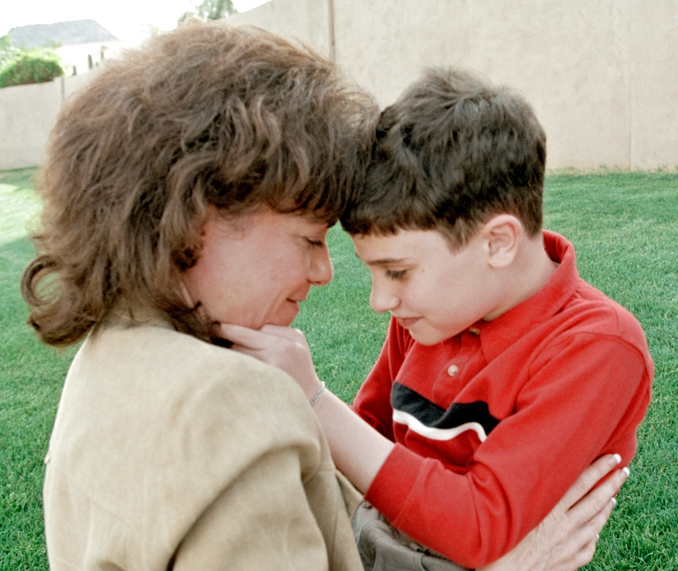
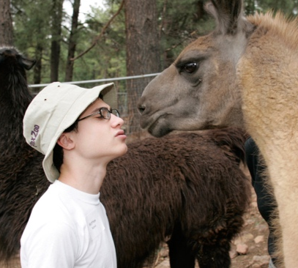
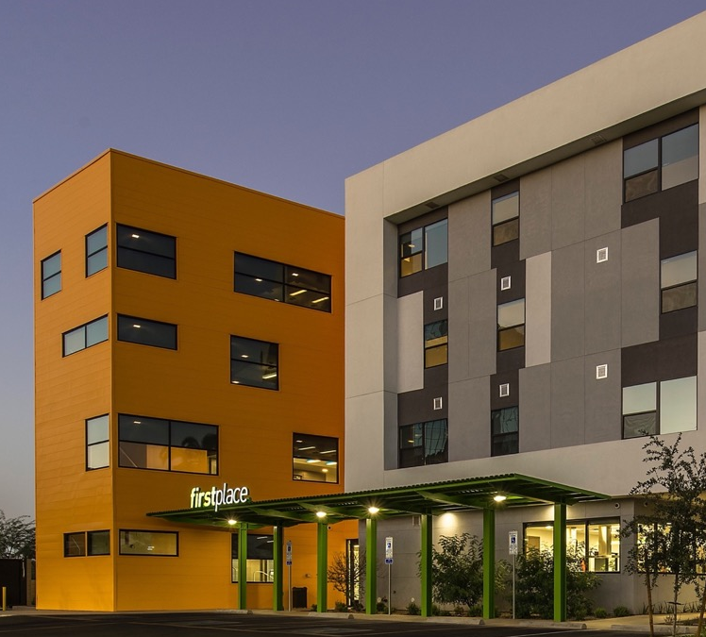
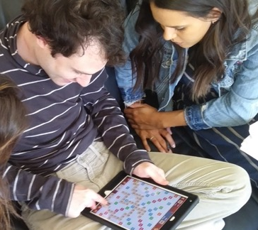
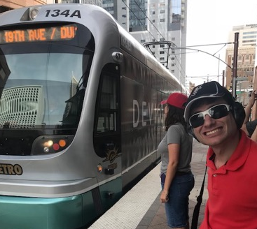

“You can’t build a community for one person.”

Slide 5

Transition Academy
(Clinically Based Program)
For participants/students
Apartments
(Supportive Housing)
Global Leadership Institute
For residents
For support providers, professionals, researchers
& policy leaders
© 2026 First Place® AZ. All Rights Reserved.
© 2021 First Place® AZ. All Rights Reserved.
© 2021 First Place® AZ. All Rights Reserved.

Slide 6




Slide 7
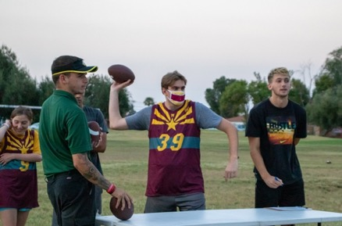
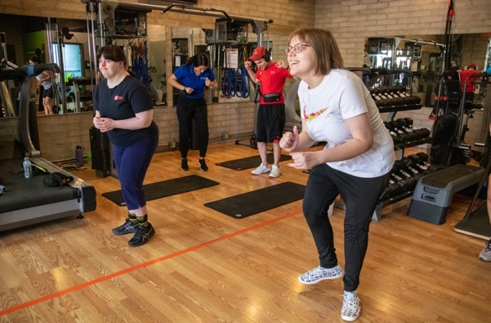
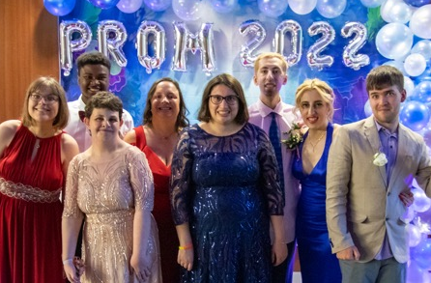
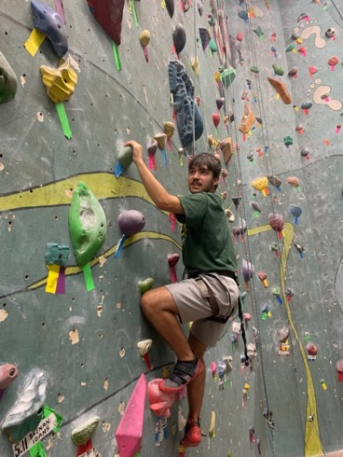
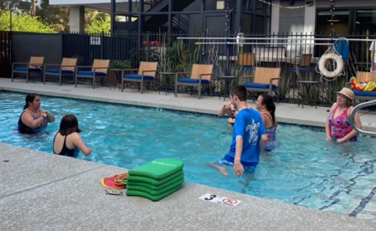
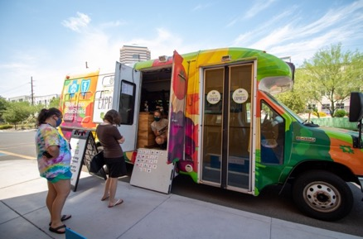
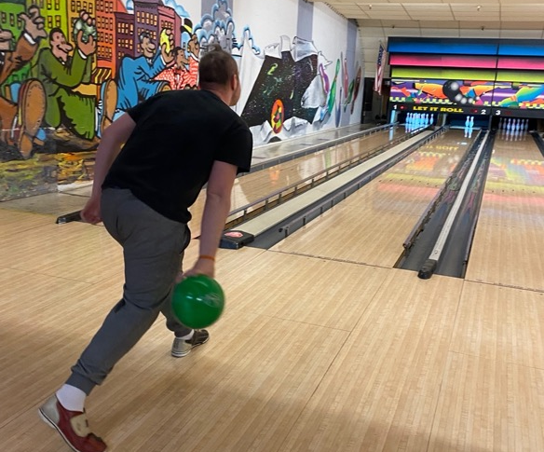
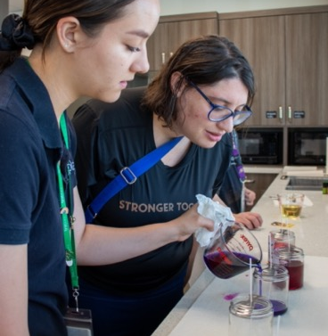
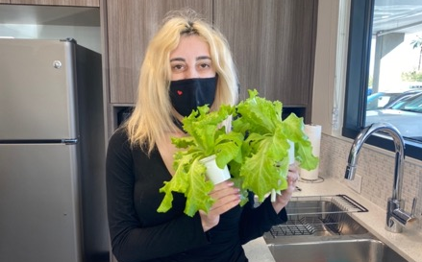
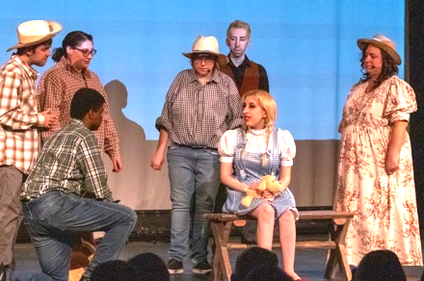
Home & Community Living
© 2021 First Place® AZ. All Rights Reserved.

Slide 8
Who We Are
Who We’re Not
Individually & family-focused
Neuro-inclusive
Research-based
Collaborative
Impact-oriented
Pioneering
Home sweet home!
Licensed
Medical home
Assisted care/congregate housing (no meals)
For those needing 24/7 care/support
For those with self-injurious/
violent behaviors

Slide 9

Apartment Amenities & Features
Transit-Oriented Midtown Location
LEGO Lounge
Game Room
Reading Lounges
24/7 Concierge & Maintenance
Building Security
Fitness Room
Culinary Teaching Kitchen
Zen Room
Pool, Patio, BBQ & Organic Garden
Health & Wellness Center

Slide 10
Apartment Supports
Time Management
Personal Care
Self-Determination
Money Management
Grocery Shopping
Basic Culinary Skills
Vocation
Transportation & Navigation
Household Management
Health & Wellness
Recreation
© 2026 First Place® AZ. All Rights Reserved.

Slide 11



Employment
Community Engagement
Self-Determination
Household
& Personal Management
Now enrolling class of 2026–2028
Clinical services provided by
© 2021 First Place® AZ. All Rights Reserved.
Notes:
Transition Academy
Operating partners SARRC provides the clinical services for our First Place residents
ABA driven objectives
Clinically based
Example of providing structured learning
4 areas for our TA program
Employment, Self-determination, Household/personal management, community engagement

Slide 12
















A comprehensive, 32-course curriculum focusing on employment and life skills. Each semester-length course comprises 16–17 modules. Information learned from courses is implemented in daily life.
$
Work
Finances
Safety
Relationships
Nutrition
Identity
Getting a job &
navigating the workplace
Money basics & personal finance
At home & in the community
Friendships & family relationships
Safety, meal planning & prep
Personal & community identity
Community
Health
Solutions
Etiquette
Transportation
Living On My Own
Organization
Roommates & community apartment living
Physical & mental health
Conflict, coping & personal management
Courtesy & manners
Travel planning, budgeting & etiquette
Creating a life
of independence
Setting goals & organizing daily life
© 2025 First Place® AZ. All Rights Reserved.

Slide 13
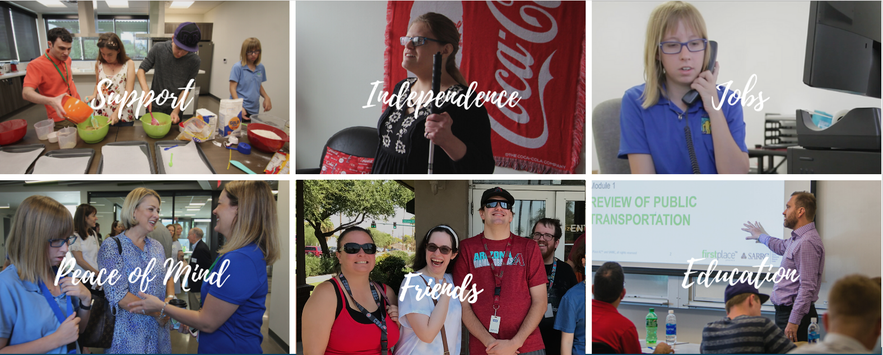
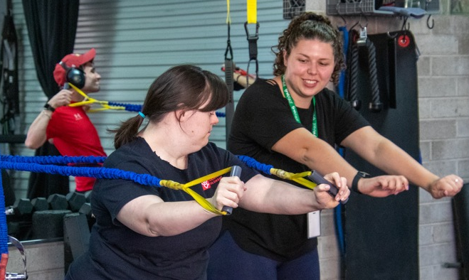
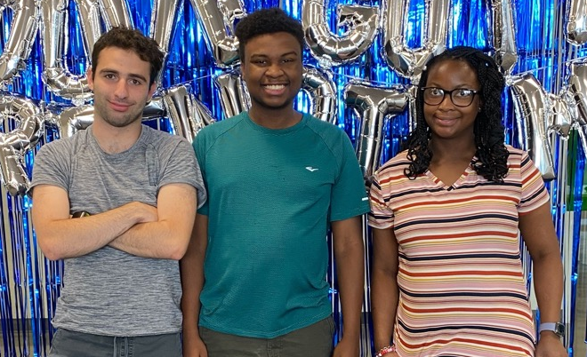
Support
Friends
© 2019 First Place® AZ. All Rights Reserved.
Communities of Opportunity
"Community is not just a physical location, it's an emotional connection.
It's where you can be yourself, experience your best life and trust people are in your corner."
– Denise D. Resnik, Matt’s Mom and First Place® AZ Founder, President/CEO
© 2025 First Place® AZ. All Rights Reserved.

Slide 14

Colonel Harland Sanders Center for Applied Research
Center for Real Estate & Community Development
Mulzet Center for Expression &
Communication
Maricopa County IDA Center for Education, Training & Employment
The Daniel Jordan Fiddle Foundation Center for Public Policy
© 2026 First Place® AZ, all rights reserved
© 2021 First Place® AZ. All Rights Reserved.
© 2021 First Place® AZ. All Rights Reserved.

Slide 15
National Housing Action Plan
Priorities for Discussion
Quality
of Life
Isolation
Housing Crisis
Business Models
Support Staff
Public Policy
Research
Adult Medical Care
Technology Platforms
Heterogeneity

Slide 16
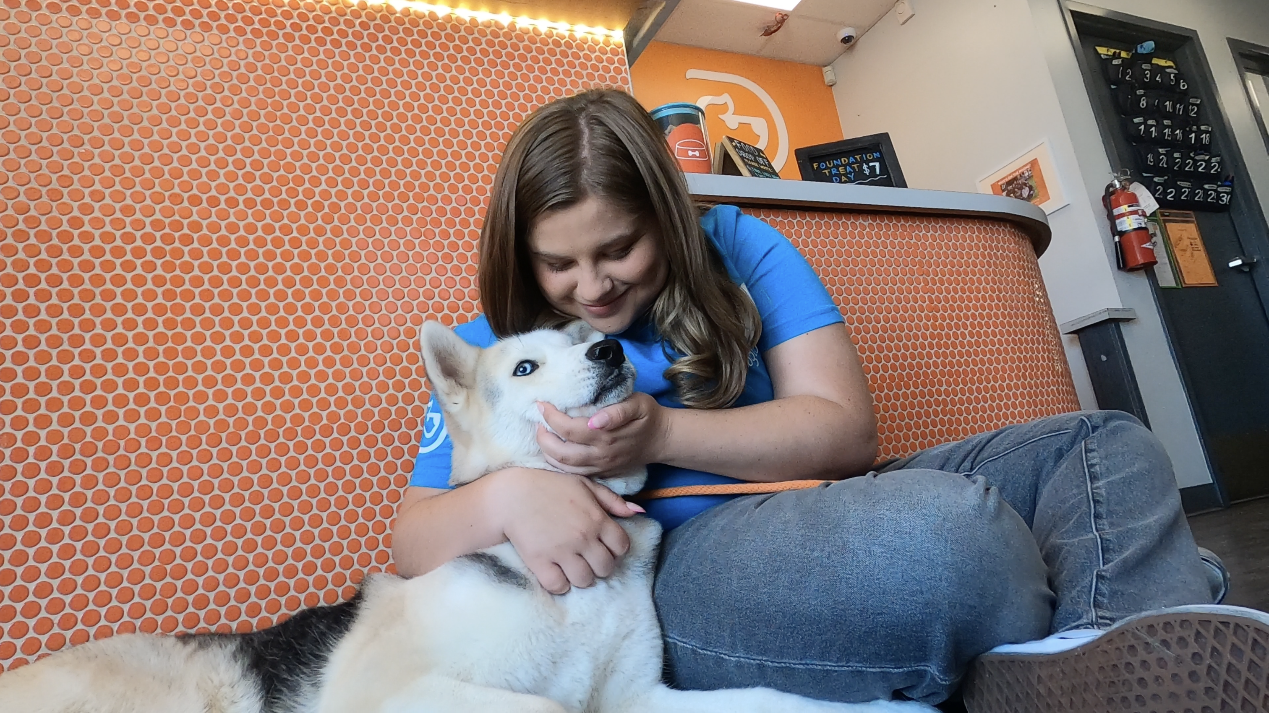
Building What Works Employment, Inclusion, and the People Ready to Prove It
Notes:
https://www.youtube.com/embed/vZT-pPEo93o

Slide 17
Bridging the Employment Gap
Employment Statistics Overview
7.2%
of individuals with a disability are unemployed
3.5%
of individuals without a disability are unemployed
85%
of Autistic adults are unemployed or underemployed
30-40%
of neurodivergent adults are unemployed
© 2024 First Place® AZ. All Rights Reserved.

Slide 18
Why This Happens
Employment Discrimination
Only ~30% of neurodivergent individuals disclose their status at work. Disclosure routinely costs people opportunities.
Hiring Processes That Screen People Out
Traditional interviews test social performance, not job skills. That's not the same thing.
Lack of Supports and Accommodations
Most workplaces assume accommodations are costly or complex. They're usually neither.
© 2021 First Place® AZ. All Rights Reserved.

Slide 19
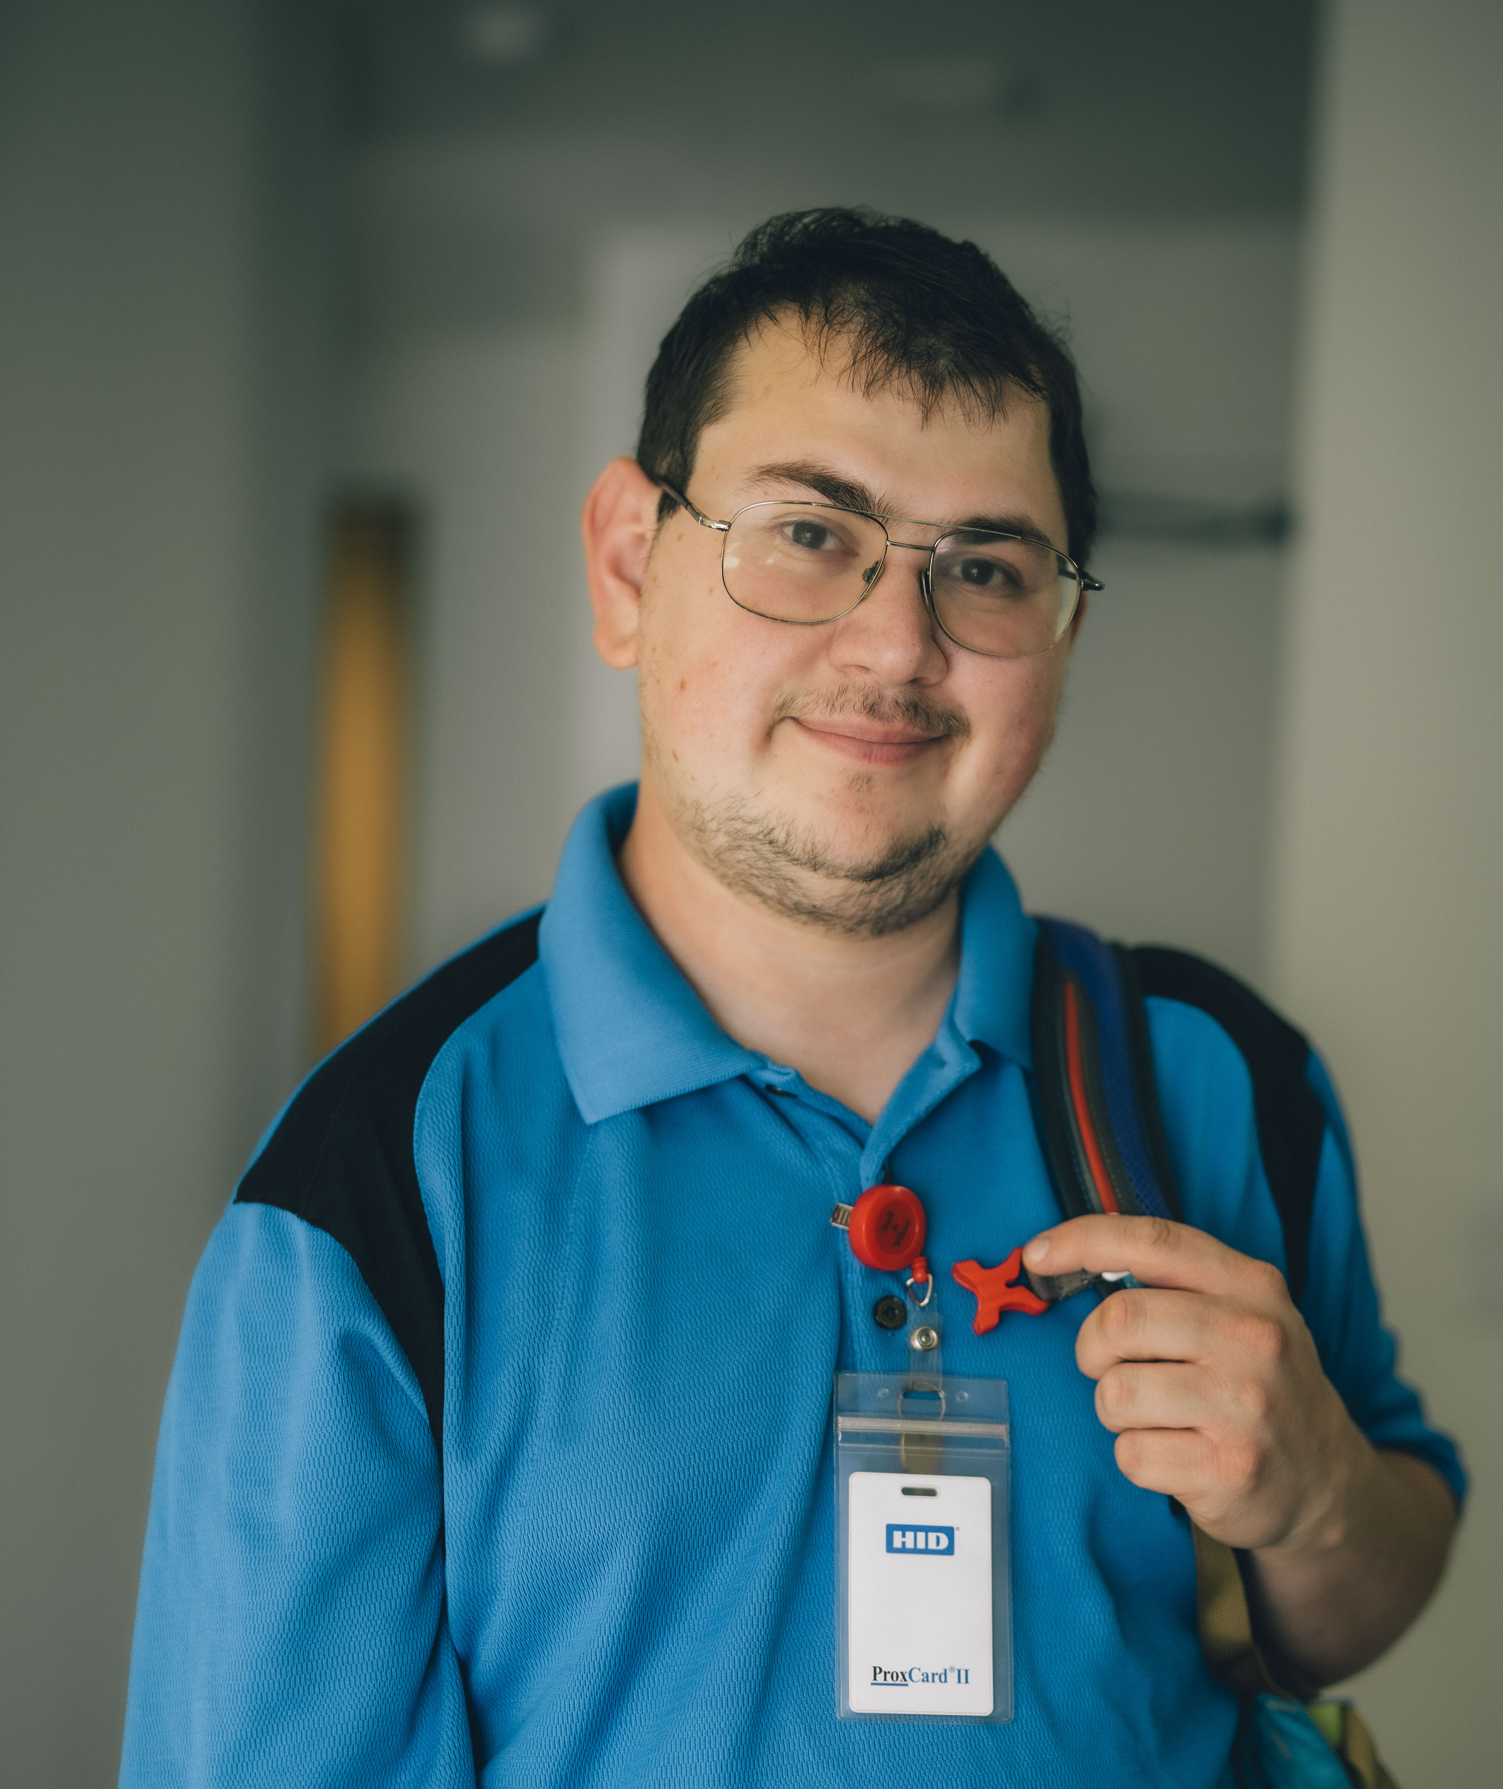

Who We Support: The People at the Center of Everything We Do
We support adults with autism, intellectual and developmental disabilities (I/DD), and/or other neurodiversties— people who are ready, capable, and too often overlooked by conventional hiring systems.
Our residents live, work, and build their lives in community. Many are employed or actively working toward employment. All of them deserve workplaces that are actually built to let them succeed.
Together, we don’t just focus on finding a job. We
build the conditions for them to stay.
Notes:
Research shows productivity increases up to 140% in some roles when neurodiverse employees are well-supported. They accelerate innovation, improve culture, and build loyalty.

Slide 20
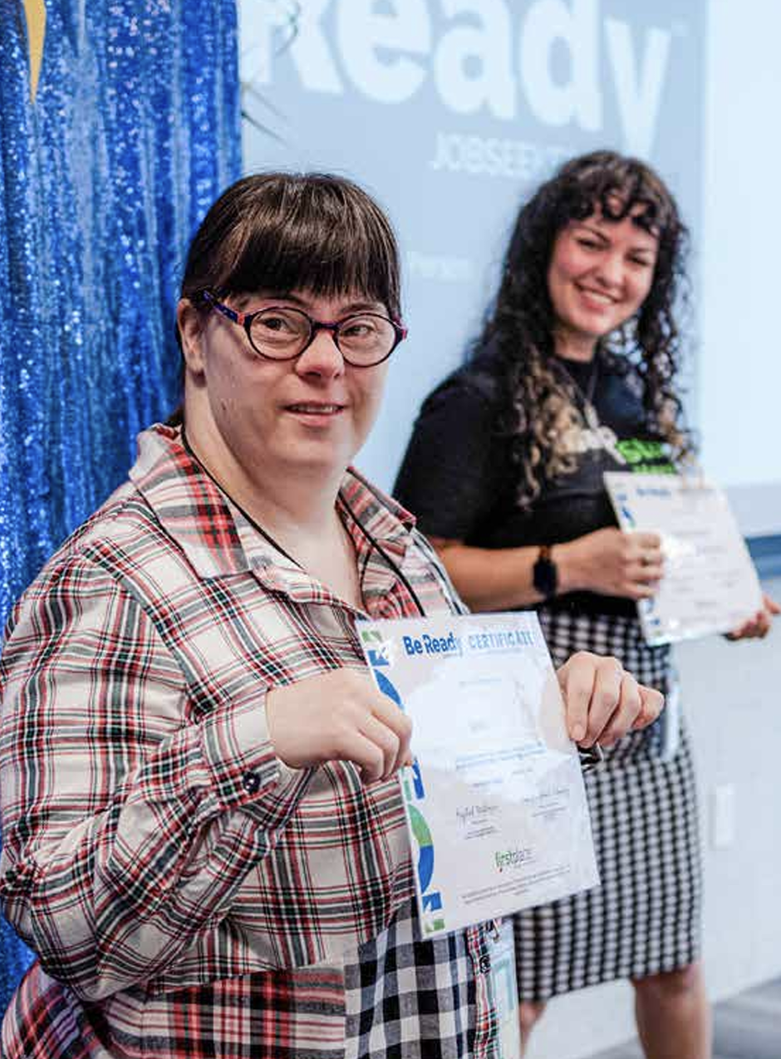
Be Open + Be Ready ®
It’s working - one job at a time.
Since mid-2024: Nearly 200 jobseekers have enrolled in First Place AZ employment programs
Mid-2024-present: 76 jobseekers enrolled in Be Ready curriculum
2025: 36 jobseekers completed 10-week class; 50% secured employment
200
76
50%

Slide 21
What We Do:
First Place - Phoenix
Employment Support Built into How We Live
For First Place – Phoenix residents, employment support isn’t a separate service – it’s part of home.
Our Employment Team works one-on-one with resident’s to:
Explore interests and map a career path
Build job readiness - resume, interviews, transportation, workplace professionalism
Connect with employers organically and through our community partner network
Provide ongoing coaching and support throughout employment for the resident and employer
© 2026 First Place® AZ. All Rights Reserved.

Slide 22
What We Do:
First Place Global
Be Open + Be Ready®: A Training Ecosystem
Be Open + Be Ready® works with everyone involved in the employment relationship — not just the job seeker.
For Employers — assessment, preparation, and curriculum to build genuinely neuro-inclusive workplaces
For Job Seekers — skills assessment, job readiness training, and one-on-one support
For Job Coaches — core competency certification and tiered training
One program. Three sides of the same door.
© 2026 First Place® AZ. All Rights Reserved.

Slide 23
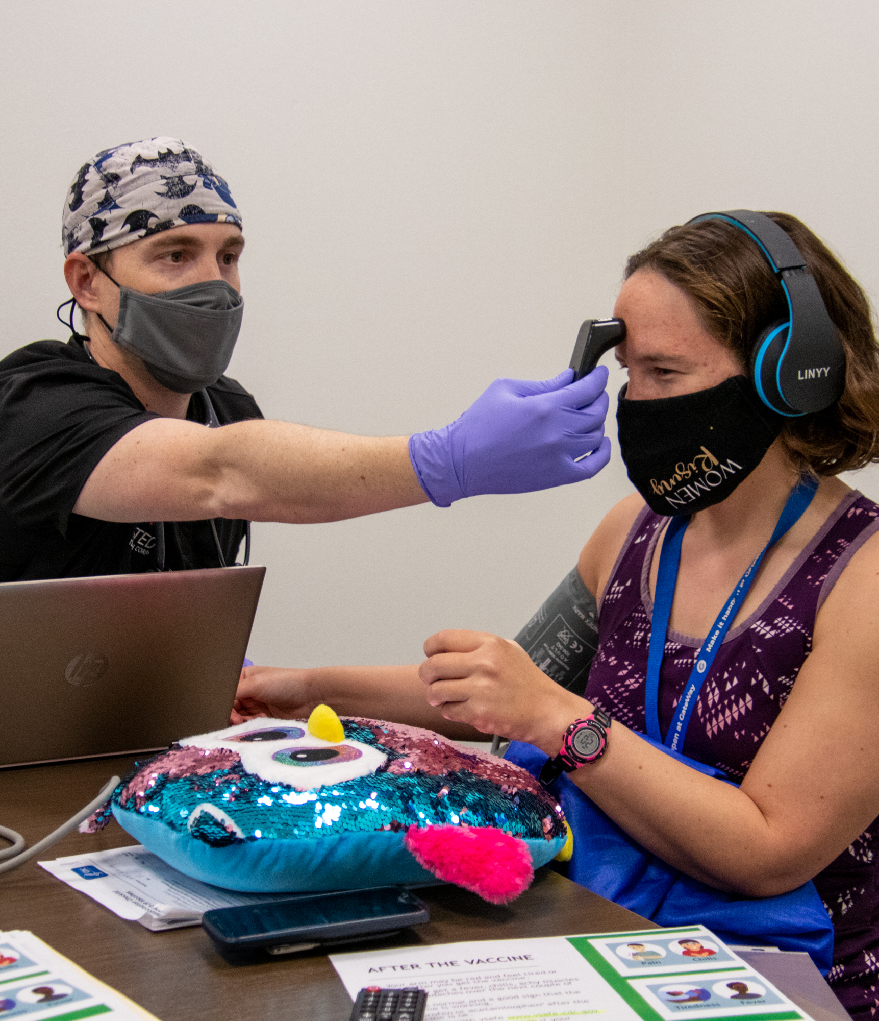

Health & Wellness Initiative
Informing public health delivery systems in Greater Phoenix for transitioning adolescents and adults with autism and/or I/DD.
© 2026 First Place® AZ, all rights reserved.

Slide 24
Identification and access to a wide range of social services and medical and behavioral health resources within our healthcare system that support healthy living.
Navigating daily living skills in an existing complex health and social services system that presents enormous challenges for adults with autism and/or I/DD.
Identifying major obstacles impacting the overall health and wellness of individuals and families because of limitations in services and challenges to accessing community resources, including physical and behavioral health and social services.
Preparation for ever-increasing demand by the ever-increasing population of adults with autism and/or I/DD, with an estimated 70,000+ individuals in the U.S. transitioning to adulthood annually.
What’s Lacking
© 2026 First Place® AZ, all rights reserved.
Notes:
Over the last twelve years we have identified what's lacking –both locally and nationally:
Identification and access to medical and behavioral services for adults on the spectrum, challenges navigating daily living skills in an complex health and social services system, the continuing need to identify the major obstacles that impact overall health and wellness for adults on the spectrum and a need to prepare for the approximately 50-60,000 individuals on the spectrum transitioning to adulthood annually.

Slide 25
What’s Needed
A healthcare equity model and better treatment approach where ​no one goes untreated or
is medically misunderstood because of
autism and/or I/DD.
© 2026 First Place® AZ, all rights reserved.
Notes:
As a result, we believe that what’s needed is a healthcare equity model and better treatment approach where ​no one goes untreated or is medically misunderstood because of autism and other neurodiversities in Arizona…and beyond.

Slide 26


®
Curriculum
© 2026 First Place® AZ, all rights reserved.

Slide 27
Course Overview
Audiences
Individuals
Staying Healthy for Individuals with Autism and Related Disorders
Family Members
Supporting Independence for Families and Support Providers
3 courses
3 distinct audiences
10 learning modules per course
Healthcare professionals
Implementing Care for Physicians and Other Healthcare Providers
Notes:
Using a comprehensive approach that begins with health and wellness and primary prevention, the initiative aims to establish a continuous spectrum of health within a community framework through three courses of 10 modules each.

Slide 28
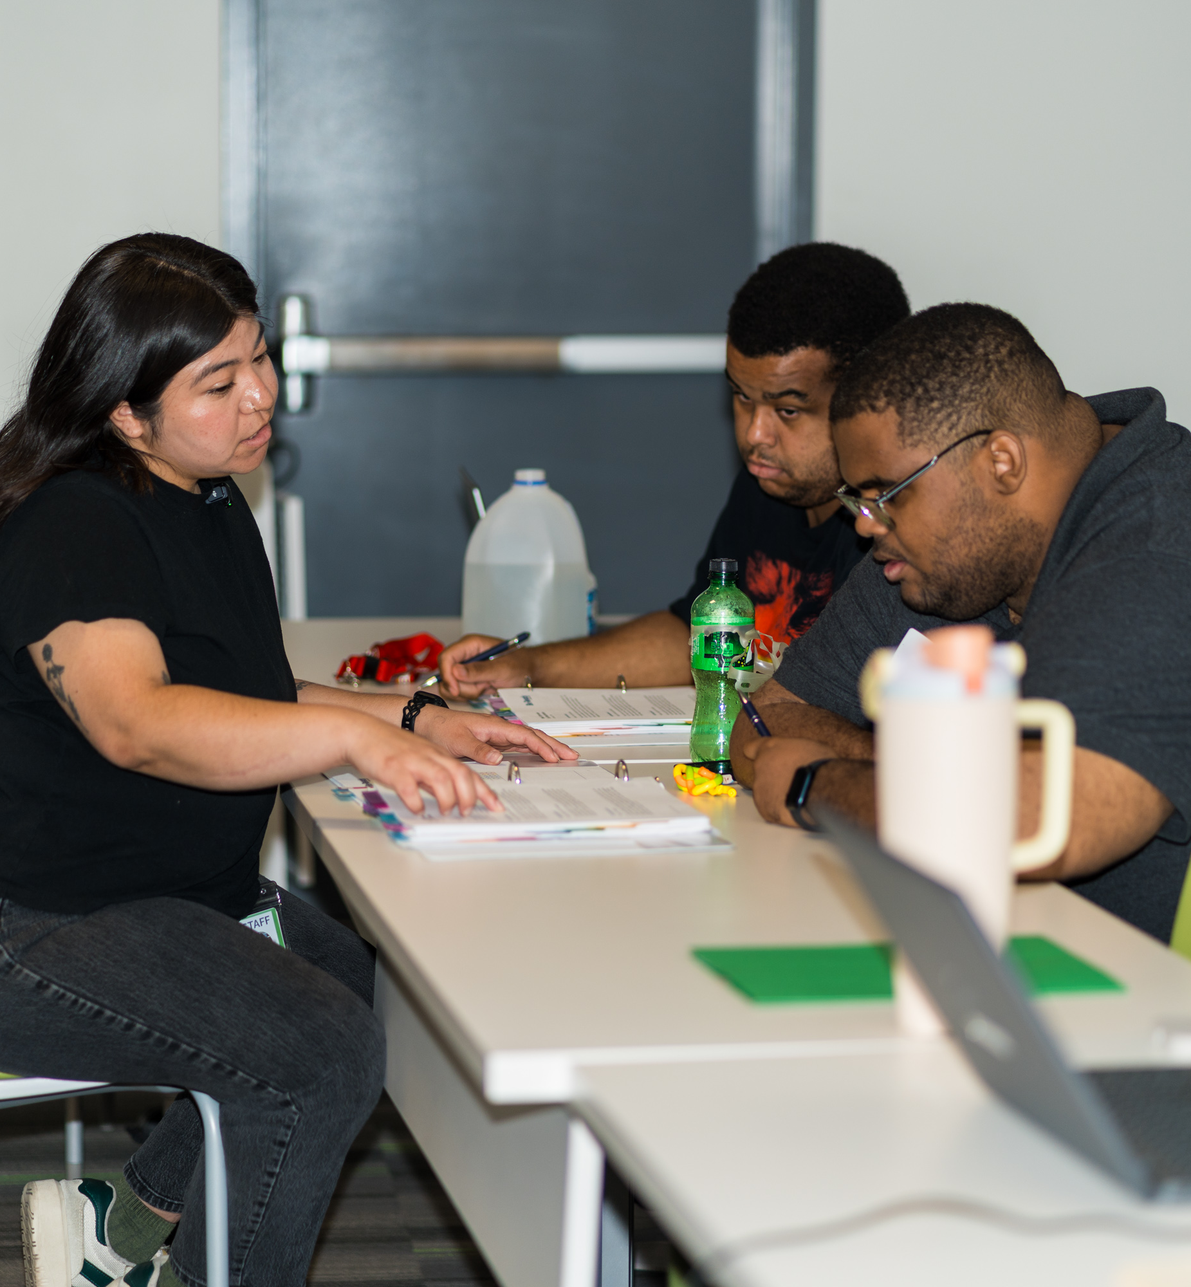
Staying Healthy: Adults with A/I/DD
My current profile
My personal self-advocacy
Establishing my medical network
My specialists
My routine
Knowing when I have symptoms
Illness vs. injury
Hospital stays
Organizing myself
My annual physical
© 2026 First Place® AZ, all rights reserved.
Notes:
My current profile: mapping my medical needs and support network
My personal self-advocacy: understanding the Patient Bill of Rights and developing my self-advocacy toolkit
Establishing my medical network: creating a portfolio of providers, professionals and navigators
My specialists: building out my medical network for specialist care
My routine: managing prescriptions and monitoring my health
Knowing when I have symptoms: a toolkit for identifying, articulating and tracking symptoms
Illness vs. injury: learning when and how to use urgent care and the emergency room
Hospital stays: deploying my medical toolkit for a hospital stay
Organizing myself: developing a medical management system for myself, including an electronic health record
My annual physical: preparing for and visiting my primary care physician

Slide 29
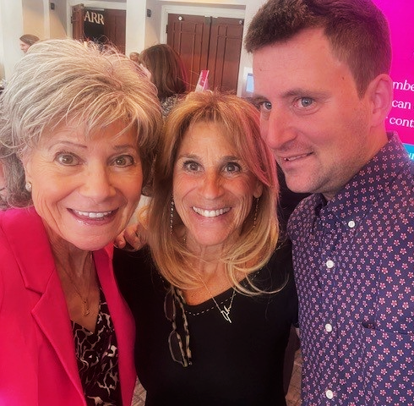
Supporting Independence: Families & Caregivers
Medical self-advocacy
Medical independence
Skills and confidence
Team and trust
Family and medical history
Electronic health records
Medical emergencies
Team and communication
Your health transition
Peace of mind
© 2021 First Place AZ, all rights reserved.
© 2026 First Place® AZ, all rights reserved.
Notes:
Medical self-advocacy: understanding the changing landscape of patient rights and parent support during medical transition
Medical independence: learning tips for supporting adult medical responsibility and self-advocacy
Skills and confidence: using a toolkit to foster medical responsibility and self-advocacy
Team and trust: building a strong circle of medical support for peace of mind
Family and medical history: understanding autism as a complex multi­system condition
Electronic health records: establishing a foundation for independent medical management
Medical emergencies: using a toolkit for proactive planning
Team and communication: supporting the support team in cultivating medical independence for the individual
Your health transition: supporting your health and wellness as your child becomes an adult
Peace of mind: identifying what this means to you; what else needs to be done?

Slide 30
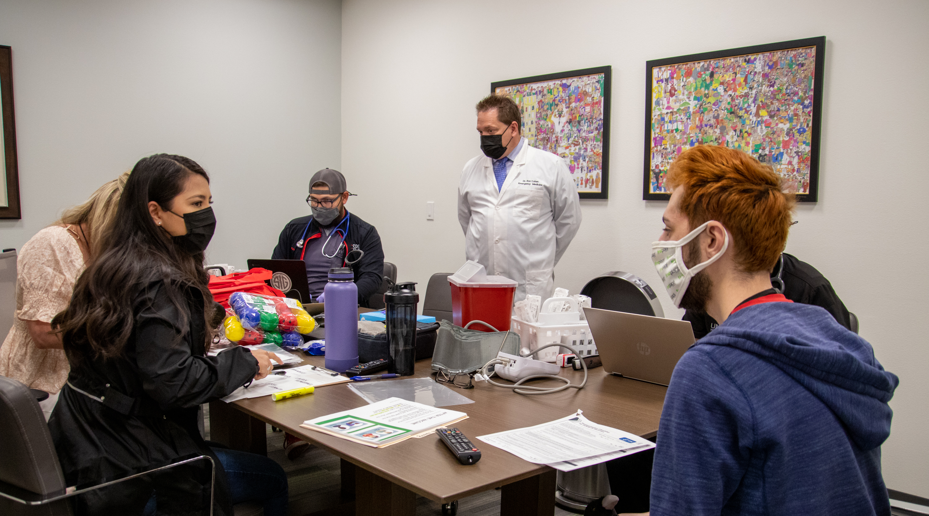
Peace of Mind
Developing a portfolio to support health and wellness
© 2026 First Place® AZ, all rights reserved.

Slide 31
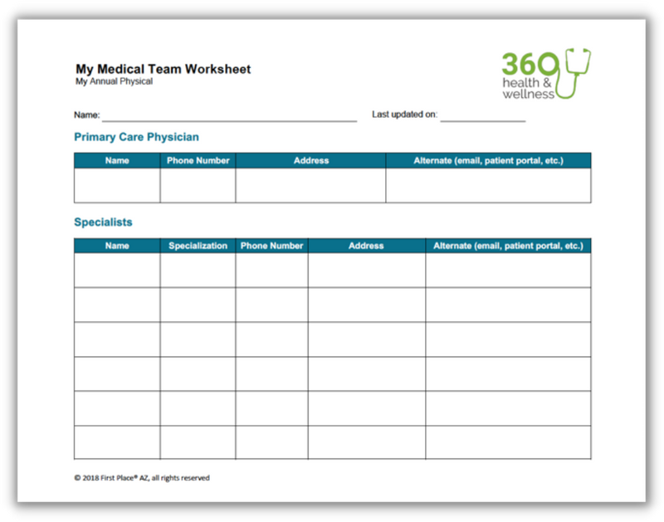
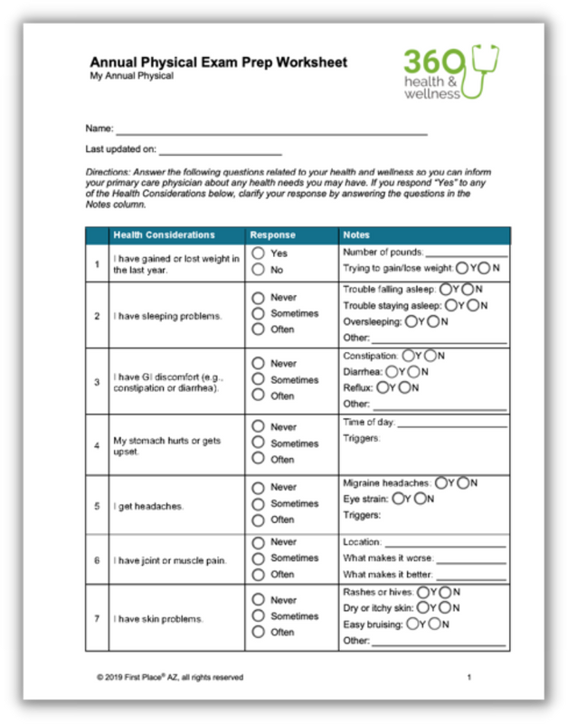
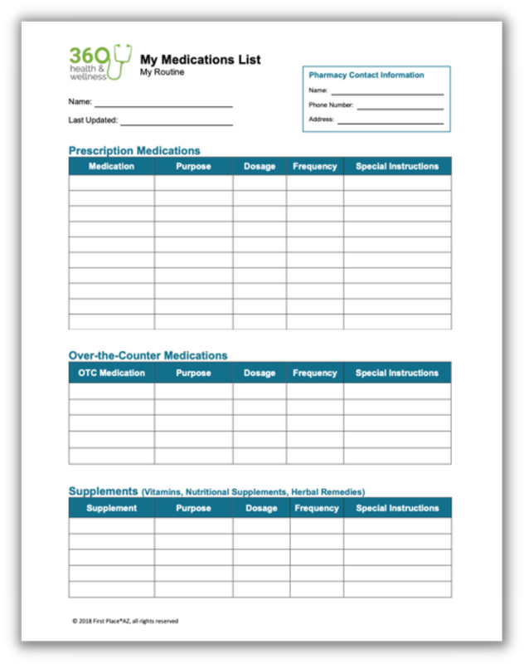
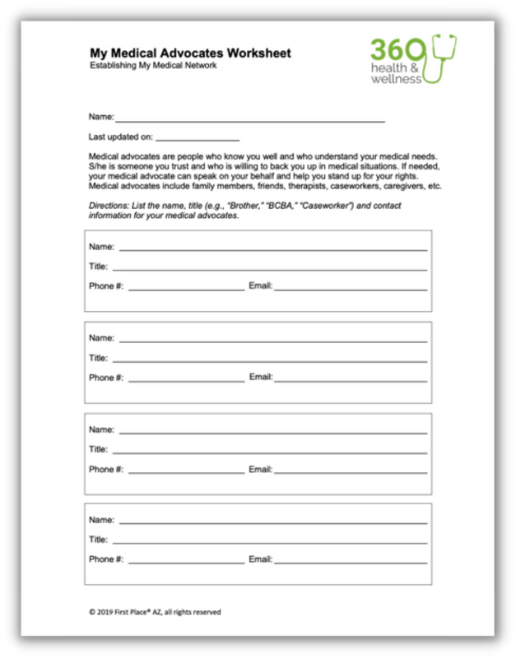
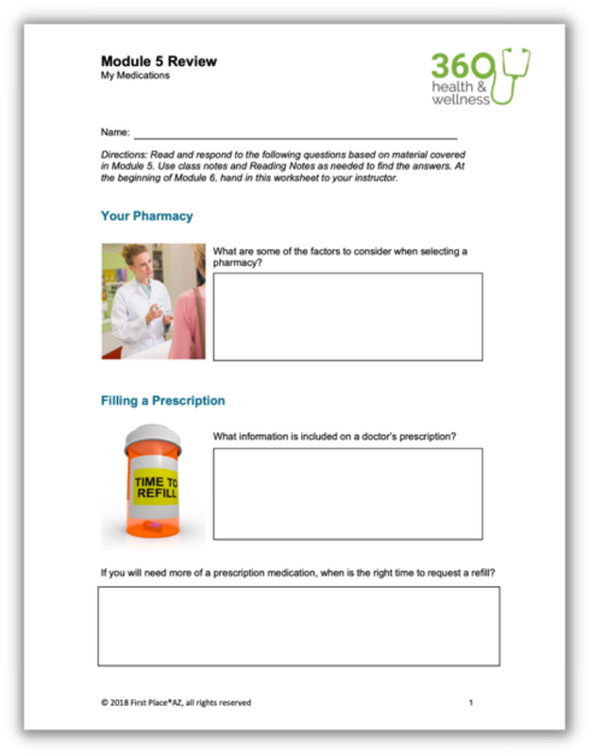
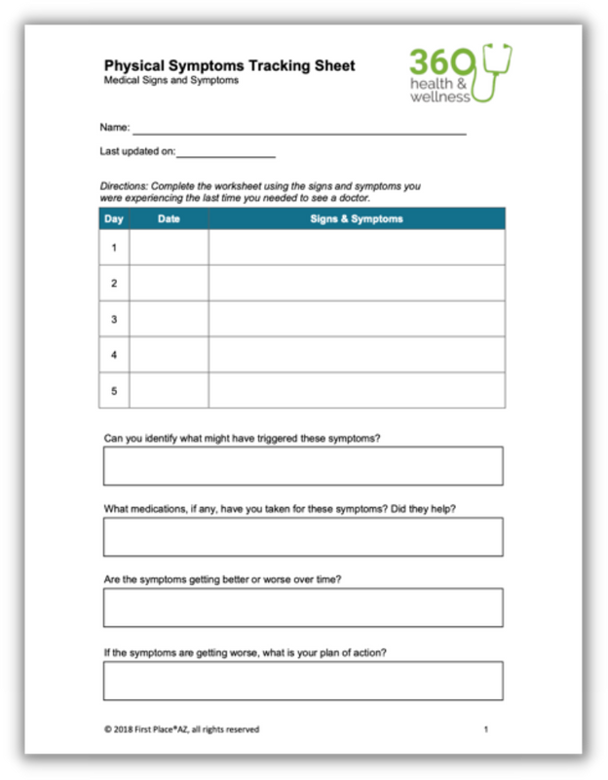
®
© 2026 First Place® AZ, all rights reserved.
Notes:
With over 30 documents, each adult and their family can individualize their portfolio, addressing their specific health and wellness needs.
11

Slide 32
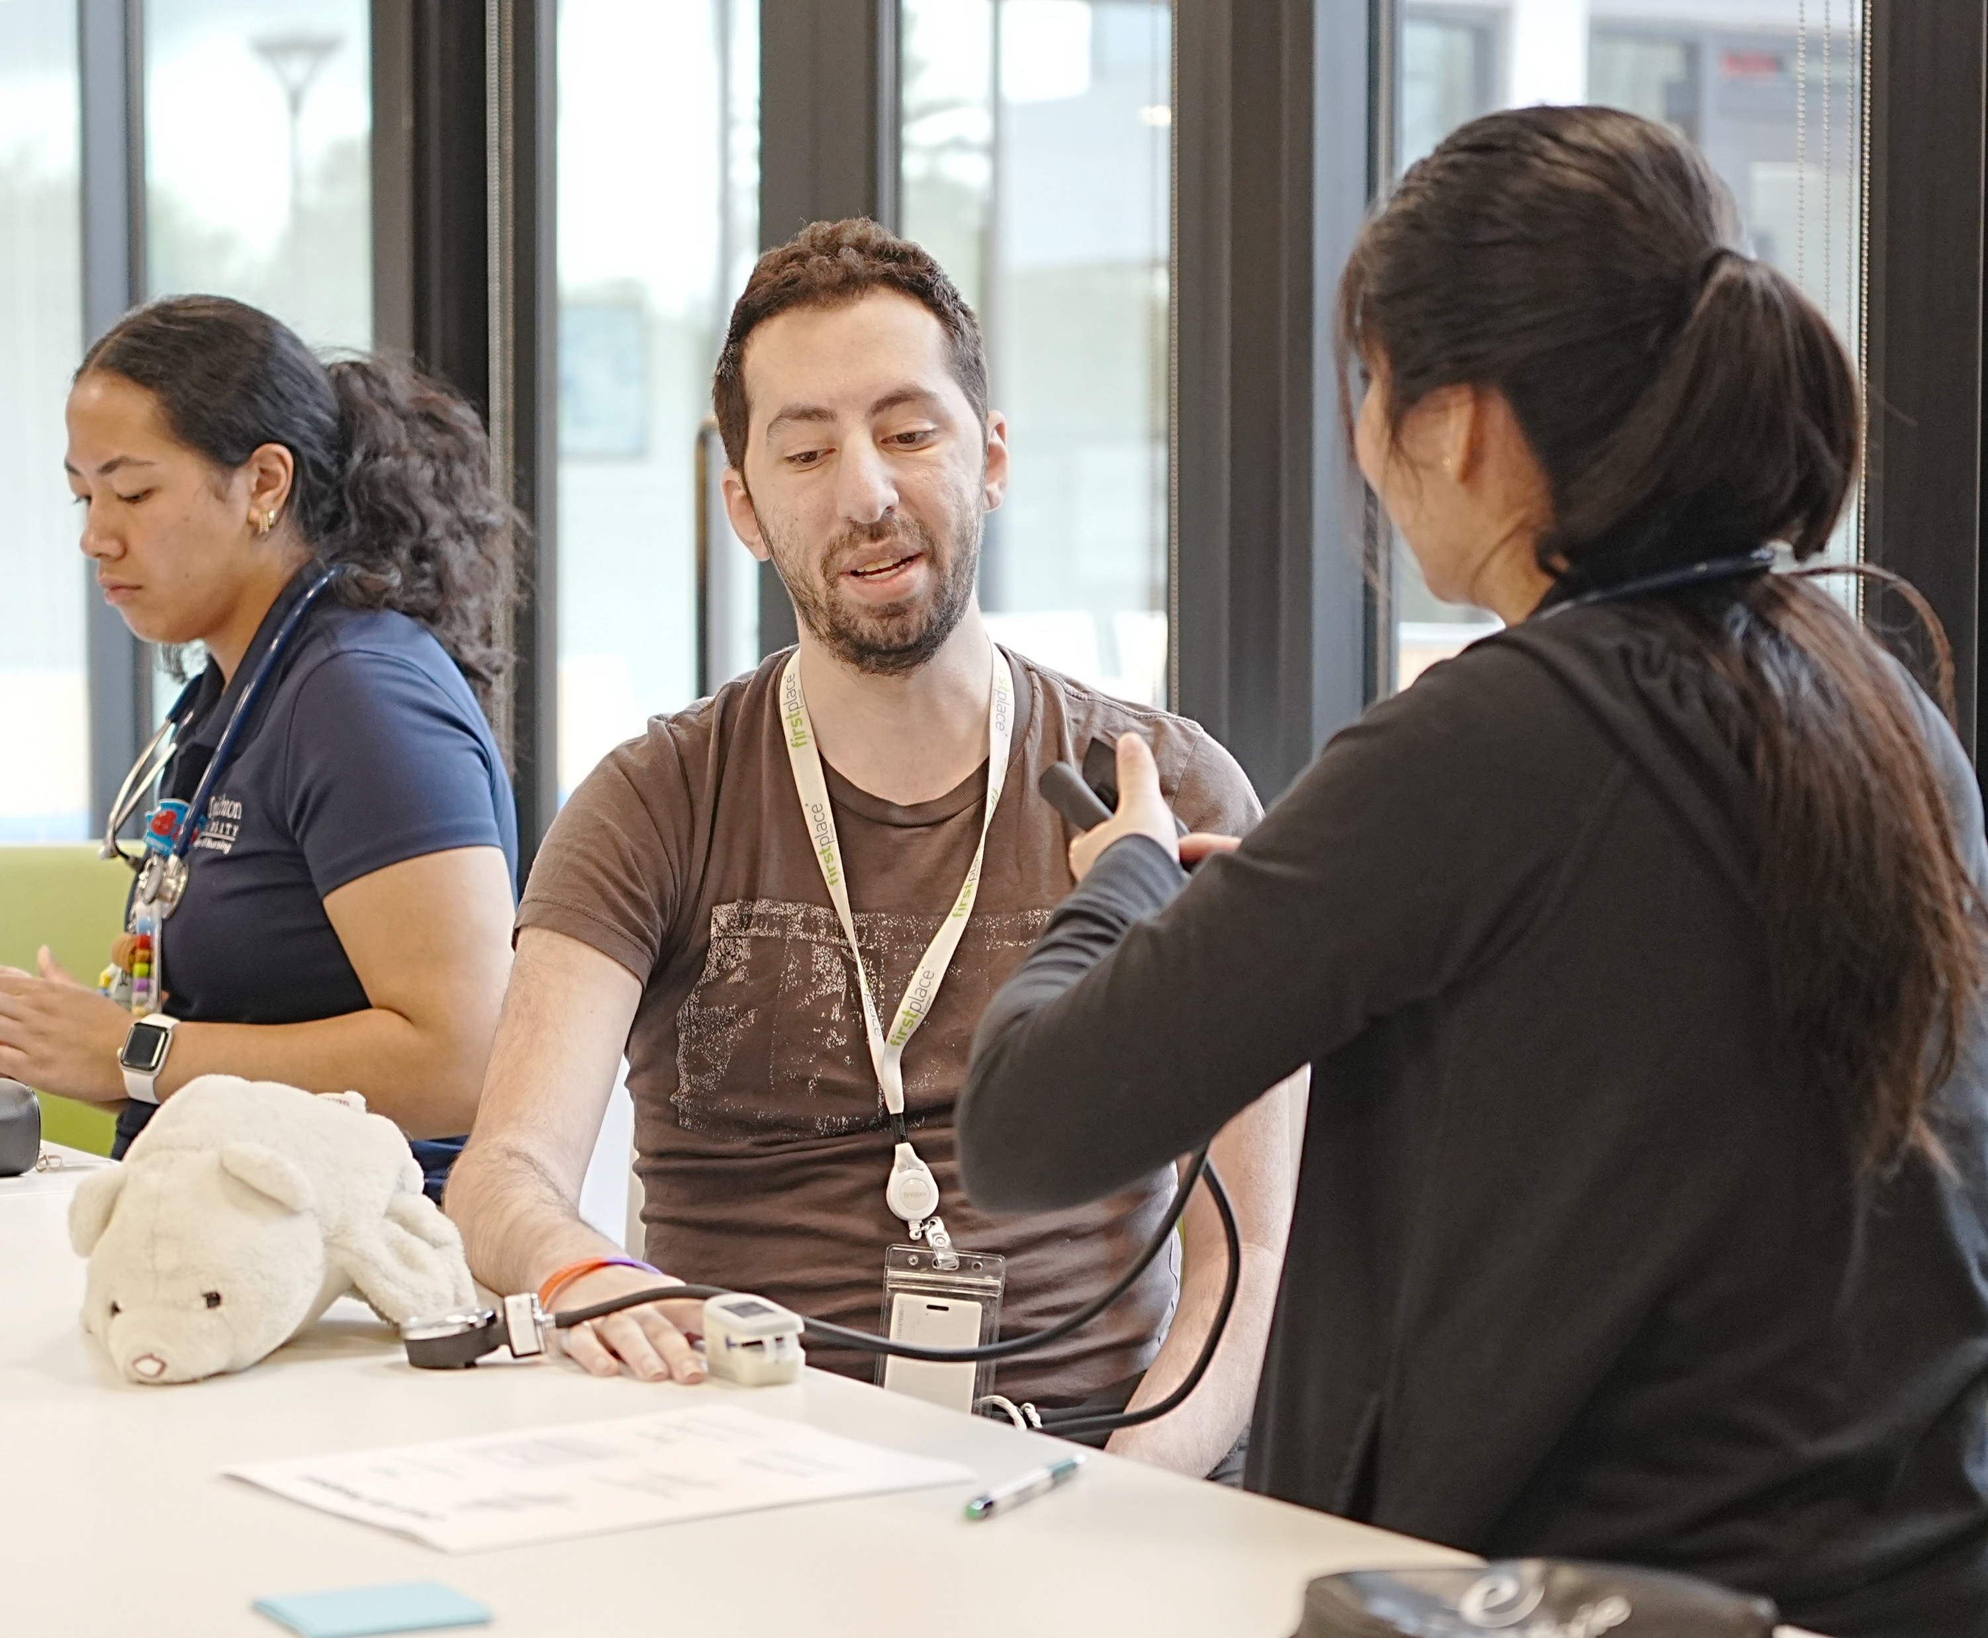
Implementing Care: Healthcare Professionals
Beyond autism
Sensory support
Communication support
Intake and triage
Medical procedures
Reading stress
Behavior is communication
Team autism
Team training & role-playing
Patient rights
© 2021 First Place AZ, all rights reserved.
© 2026 First Place® AZ, all rights reserved.
Notes:
Beyond autism: putting medical treatment ahead of core characteristics and behaviors
Sensory support: using a sensory profile to ensure a welcoming environment and effective treatment
Communication support: providing communication options to ensure effective assessment and treatment
Intake and triage: gaining a medical picture with a visual and communication toolkit
Medical procedures: using the show, model, tell toolkit for basic procedures
Reading stress: learning about social and environmental triggers to support patient care
Behavior is communication: assessing behavior as a clinical instrument for knowledge
Team autism: developing staff policies and procedures for supporting adults with autism
Team training & role-playing: activities for implementing autism- and disability-friendly health and wellness care
Patient rights: utilizing support and staff while upholding patient rights and preferences

Slide 33
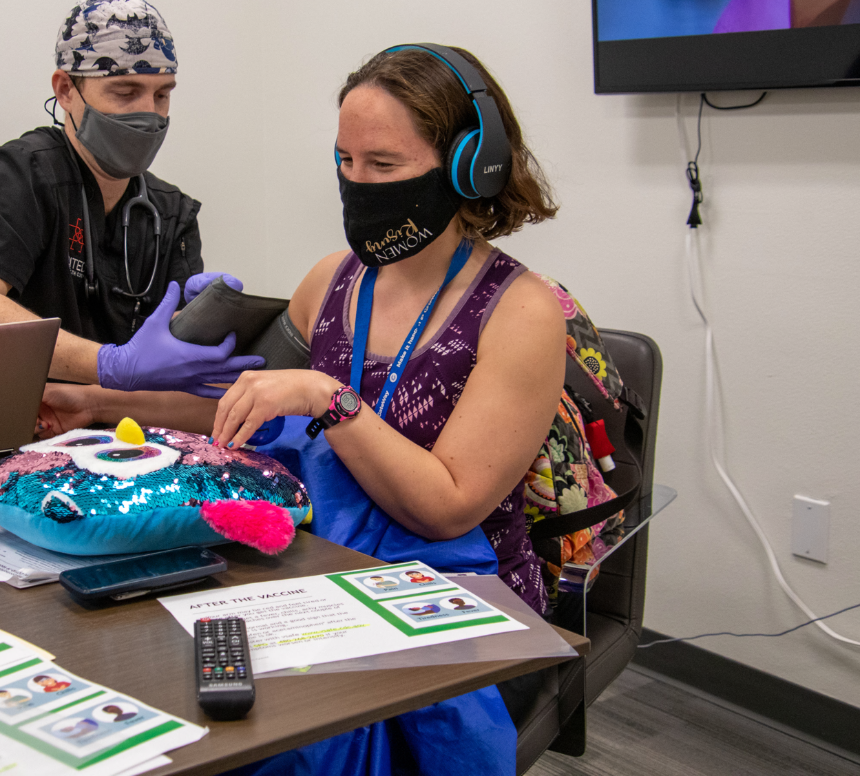


®
Medical Elective
Adults with Autism
Clinical
Observing, interviewing, charting a treatment plan
Community-Based
Observing & experiencing school/intervention programs
Partnering
Learning from individuals directly affected through shared activities
Reflection
Using current/past research & elective experiences to reflect and chart a future course
© 2026 First Place® AZ, all rights reserved.
Notes:
This innovation elective enables the Creighton medical student to experience First Place-Phoenix, learn directly from individuals with autism about their challenges and triumphs, and to experience their everyday activities. Medical students participate in the onsite clinic, learn how to perform biopsychosocial interviews with neurodiverse adults, partner with a specific adult on a health and wellness goal, and can reflect on current and future research and how their learning will support their future practice of medicine.
Experience adults with autism and/or I/DD patients under the supervision of Dr. Tina Younger through patient evaluations and treatment using current, evidence-based guidelines.
Participate in public health and psychosocial experiences and related activities occurring in the clinic, within the First Place–Phoenix apartment community and through broader community opportunities.
Provide exposure to a range of services and supports available to individuals with autism—from early diagnosis and education through adulthood.
This elective ran from 2021-2025 with a total of 20 students participating.

Slide 34
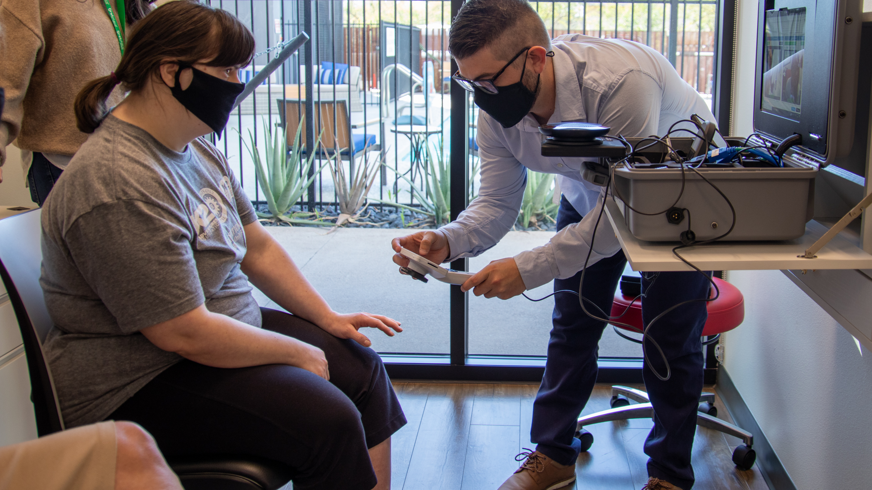
2026 Healthy Steps Forward
1
Expand implementation of First Place 360 Health & Wellness Curriculum.
2
Advance collaborations with academic institutions to further comprehensive autism education.
3
Broaden the reach for the 360 Health & Wellness Implementing Care CEU.
© 2026 First Place® AZ, all rights reserved.

Slide 35
Contact Olivia for more info!
Upcoming Tours
October 26 & 27 | 12:00p–1:00p
First Place–Phoenix
3001 N. 3rd St. Phoenix, 85012
Office Hours
October 29 | 11:00a–12:00p
November 4 | 3:00p–4:00p
© 2026 First Place® AZ, all rights reserved.

